Slide 1
Custom Workflow Template
Rachel Wright, Author Jira Strategy Admin Workbook
Notes:
Custom Workflow Template by Rachel Wright, Certified JIRA Administrator and author of the JIRA Strategy Admin Workbook
Need help cleaning-up or maintaining your Jira instance? Learn more at: jirastrategy.com

Slide 2
Narrative
Mary is on a Marketing team and manages customer email communications for products. She receives requests to modify or create new message templates. She reviews the requests to determine the next steps. If the request is quick and easy, she can assign it to a team member immediately. If the request is complex, it often requires a follow-up discussion with the requestor. Sometimes support is needed from other teams. For example: IT needs to create landing page or the pricing team needs to create a coupon code. After the initial work is complete, the message template is shown to the product and sales teams for approval. If all is well, the request is done. Sometimes Mary receives requests the team can’t act on yet. Those are put on hold to work on later.
On the following slides, fill in the needed workflow
statuses, transitions, and transition behaviors.

Slide 3
Narrative
“[elements of this phase]”
Related statuses: [insert]
“[elements of this phase]”
Related statuses: [insert]
“[elements of this phase]”
Related statuses: [insert]
“[elements of this phase]”
Related statuses: [insert]

Slide 4
Statuses
Key: Status =
[label]
[status]
[status]
In Words:
[insert explanation]

Slide 5
Statuses + Forward Transitions
Key: Status = , Transition Button = , Happy Path =
[label]
[label]
[status]
[status]
[transition]
In Words:
[insert explanation]

Slide 6
Statuses + Alternate Transitions
Key: Status = , Transition Button = , Happy Path = , Alternate Path =
[label]
[label]
[status]
[status]
[transition]
[transition]
In Words:
[insert explanation]

Slide 7
Transition Behaviors
Status | Transition > Destination | Behaviors
[status] | [transition] > [destination] | [insert]
[status] | [transition] > [destination] | [insert]
[status] | [transition] > [destination] | [insert]

Slide 8
Narrative
Mary is on a Marketing team and manages customer email communications for products. She receives requests to modify or create new message templates. She reviews the requests to determine the next steps. If the request is quick and easy, she can assign it to a team member immediately. If the request is complex, it often requires a follow-up discussion with the requestor. Sometimes support is needed from other teams. For example: IT needs to create landing page or the pricing team needs to create a coupon code. After the initial work is complete, the message template is shown to the product and sales teams for approval. If all is well, the request is done. Sometimes Mary receives requests the team can’t act on yet. Those are put on hold to work on later.
NOTE: This is one of many possible solutions. Do what’s best
for your teams without cluttering up your Jira instance.

Slide 9
Narrative Phases
“Mary is on a Marketing team and manages customer email communications for products. She receives requests to modify or create new message templates.”
Related statuses: Open
“She reviews the requests to determine the next steps. If the request is quick and easy, she can assign it to a team member immediately. If the request is complex, it often requires a follow-up discussion with the requestor. Sometimes support is needed from other teams...”
Related statuses: In Review, In Progress, Info Needed
“After the initial work is complete, the message template is shown to the product and sales teams for approval. If all is well, the request is done.”
Related statuses: Awaiting Approval, Closed
“Sometimes Mary receives requests the team can’t act on yet. Those are put on hold to work on later.
Related statuses: On Hold

Slide 10
Statuses
Key: Status =
[label]
Open
In Review
In Progress
Awaiting Approval
Closed
On Hold
Info Needed
In Words:
Requests are received in the initial “Open” status. An issue moves to the “In Review” status and is assigned to a team member. The email template is created or updated in the “In Progress” status. Business teams approve the template in the “Awaiting Approval” status. If all is well, the issue moves to it’s final “Closed” status. The “On Hold” status is used if an issue cannot be worked. The “Info Needed” status is used if more details or work from other teams is needed.

Slide 11
Statuses + Forward Transitions
Key: Status = , Transition Button = , Happy Path =
[label]
[label]
Open
In Review
In Progress
Awaiting Approval
Closed
On Hold
Start Review
Start Progress
Request Approval
Pass
Info Needed
In Words:
Requests are received in the initial “Open” status. A user clicks the “Start Review” transition button when the team is ready to review the request. A user clicks the “Start Progress” button when work begins on the template. When work is complete, the user clicks the “Request Approval” button. If approved, the user clicks the “Pass” button and the issue transitions to the final “Closed” status. The “On Hold” status is used if an issue cannot be worked. The “Info Needed” status is used if more details or work from other teams is needed.

Slide 12
Statuses + Alternate Transitions
Key: Status = , Transition Button = , Happy Path = , Alternate Path =
[label]
[label]
Open
In Review
In Progress
Awaiting Approval
Closed
On Hold
Start Progress
Start Review
Start Progress
Request Approval
Pass
Reopen
Info Needed*
Fail
Info Needed
On Hold*
Start Progress
Close*
In Words:
Requests are received in the initial “Open” status. A user clicks the “Start Review” transition button to move to the “In Review” status. In the “In Review” status a user clicks the “Start Progress” button to move to the “In Progress” status. In the “In Progress” status, a user clicks the “Request Approval” button to move to the “Awaiting Approval” status. In the “Awaiting Approval” status, a user clicks the “Pass” button and the issue transitions to the final “Closed” status. Alternatively, a user clicks the “Fail” button to move the issue back to the “Open” status. At any time in the workflow, a user can click the “On Hold” button to move to the “On Hold” status, the “Info Needed” button to move to the “Info Needed” status, or the “Close” button to move to the final “Closed” status. In the “On Hold” status or the “Info Needed” status a user clicks “Start Progress” to move to the “In Progress” status. * = global transitions (Not all shown.)

Slide 13
Transition Behaviors
Status | Transition > Destination | Behaviors
All | Close > Closed | Screen: Resolve Issue Post Function: Fire a Issue Closed event that can be processed by the listeners.
All | Info Needed > Info Needed | Screen: Assignment
Open | Start Review > In Review | Post Function: Assign the issue to the current user.
In Progress | Request Approval > Awaiting Approval | Screen: Assignment
Closed | Reopen > Open | Post Function: The value of field Resolution will be cleared. Post Function: Fire a Issue Reopened event that can be processed by the listeners.

Slide 14
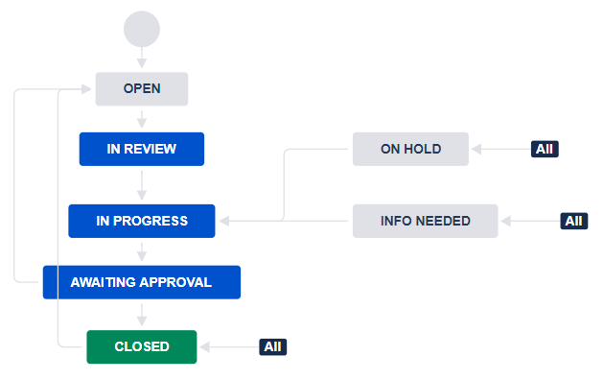
Diagram Mode

Slide 15
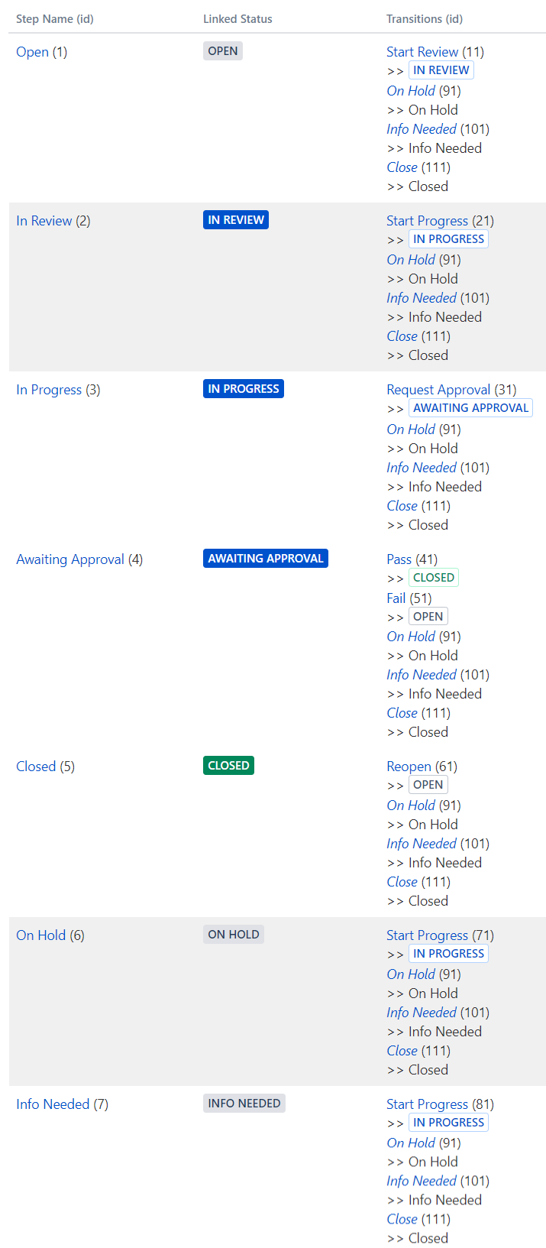
Text Mode

Slide 16
Narrative
“We start off with a search for candidates and identify ideal clients we’d like to work with. We acquire a lead through various lead generation methods. We do company research prior to meeting with the candidate. We book a meeting. At the meeting, we use our “Fact Finding Template” and “Performance Checklist.” After the meeting we develop a solution, plan, or resources for how the consultant can help the company. For ongoing contracts, we’ll have weekly, quarterly, semi-annual, and annual meetings for their quarterly and long-term goals.”

Slide 17
Narrative Phases
“We start off with a search for candidates and identify ideal clients we’d like to work with. We acquire a lead through various lead generation methods.”
Related statuses: Open
“We do company research prior to meeting with the candidate. We book a meeting. At the meeting, we use our “Fact Finding Template” and “Performance Checklist.””
Related statuses: Planning
“After the meeting we develop a solution, plan, or resources for how the consultant can help the company.”
Related statuses: Proposal
“For ongoing contracts, we’ll have weekly, quarterly, semi-annual, and annual meetings for their quarterly and long-term goals.”
Related statuses: Active or Closed

Slide 18
Statuses
Key: Status =
[label]
Open
Planning
Proposal
Active
Closed
In Words:
A lead is acquired and on creation is in the “Open” status. Research and meetings occur in the “Planning” status. Solutions are determined and pitched in the “Proposal” status. If the proposal is accepted, the issue moves to the “Active” status where all ongoing consulting occurs. When consulting is complete, the issues moves to the final “Closed” status.

Slide 19
Statuses + Forward Transitions
Key: Status = , Transition Button = , Happy Path =
[label]
[label]
Open
Planning
Proposal
Active
Closed
Start Planning
Start Proposal
Start Consulting
Close
In Words:
A lead is acquired and on creation is in the “Open” status. The user clicks the “Start Planning” transition button to move to the “Planning” status where all research and meetings occur. The user clicks the “Start Proposal” button to determine solutions and pitch them to the customer. If the proposal is accepted, the user clicks the “Start Consulting” button to move to the “Active” status where all ongoing consulting occurs. When consulting is complete, the user clicks the “Close” button to move to the final “Closed” status.

Slide 20
Statuses + Alternate Transitions
Key: Status = , Transition Button = , Happy Path = , Alternate Path =
[label]
[label]
Open
Planning
Proposal
Active
Closed
Start Planning
Start Proposal
Start Consulting
Close*
Reopen
Skip to Proposal
Back to Open
Back to Planning
Back to Proposal
Close*
Close*
Close*
In Words:
A lead is acquired and on creation is in the “Open” status. The user clicks the “Start Planning” transition button to move to the “Planning” status. If no planning is needed, the user clicks “Skip to Proposal” to skip to the “Proposal” status. In the “Planning” status, the user clicks “Start Proposal” to move forward to the “Proposal” status or clicks “Back to Open” to move backwards to the “Open” status. In the “Proposal” status, the user clicks “Start Consulting” if the proposal is accepted. If the proposal is declined, the user clicks the “Close” button to move to the final “Closed” status. In the “Active” status, the user clicks the “Close” button when consulting is complete. In the “Closed” status, a user clicks the “Reopen” button to reopen the issue.
* The “Close” transition is global.

Slide 21
Transition Behaviors
Status | Transition > Destination | Behaviors
All | Close > Closed | Screen: Resolution Post Function: Assign the issue to the reporter. Post Function: Fire a Issue Closed event that can be processed by the listeners.
Closed | Reopen > Open | Post Function: The value of field Resolution will be cleared.

Slide 22
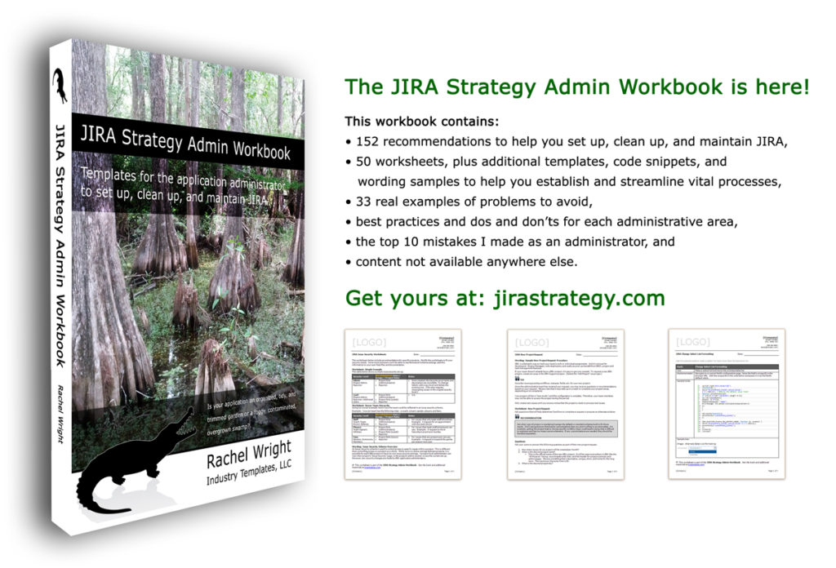
Jira Strategy Admin Workbook
Enter code skillshare at jirastrategy.com for 15% off!
Print version available at Amazon

Slide 23
Questions?
Contact: Rachel Wright
rwright@jirastrategy.com

