Slide 1
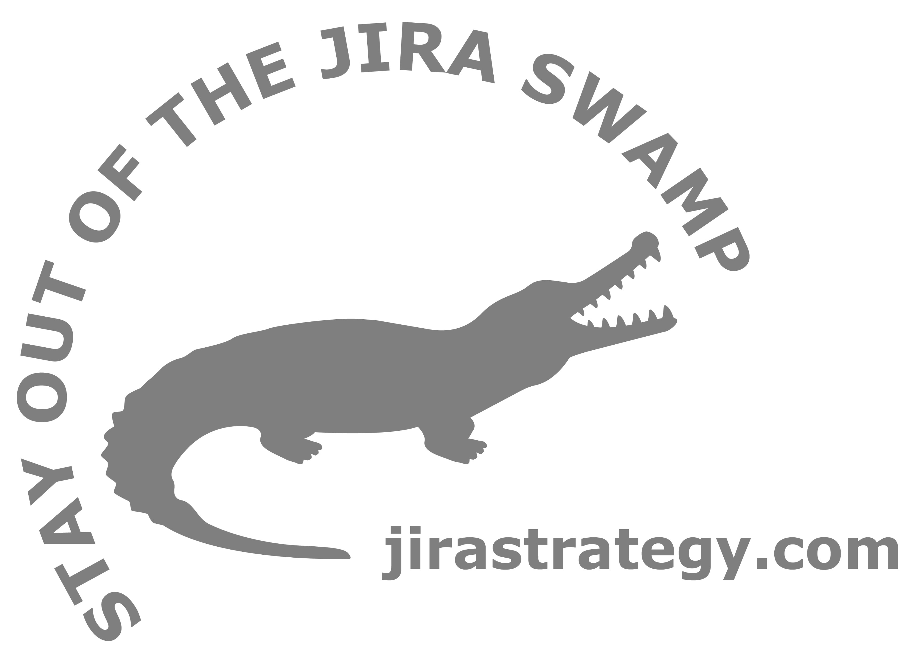
Jira Workflows for Business Teams
Rachel Wright, Author Jira Strategy Admin Workbook
Notes:
Jira Workflows for Business Teams by Rachel Wright, Certified JIRA Administrator and author of the JIRA Strategy Admin Workbook
I recently removed 28 unused workflows from a Jira application! How do you end up with that many workflows people aren’t even using? It happens when workflows are too complex, too customized, and don’t accurately reflect a team’s real-life process.
In this course, you’ll learn how to build smart workflows that your business teams will actually use!
You’ll learn:
how business workflows are different from software workflows,
best practices like good naming, appropriate use of transition behaviors, and the importance of roles and groups,
to build a workflow using a phased approach,
to avoid common workflow design mistakes,
how using add-ons extends workflow functionality,
and the “must know” concepts that apply to any type of workflow.
This course is for Jira administrators, but even if you’re not an admin, you can take this information back to your admin team. Well designed workflows should compliment a team’s process, NOT dictate it!
Need help cleaning-up or maintaining your Jira instance? Learn more at: jirastrategy.com

Slide 2
Topics
Workflow Types
Resolved ≄ Closed
Do’s and Don’ts
Custom Workflow Planning
Custom Workflow Process
Workflow Concepts
Add-ons & Plugins
Resources

Slide 3
Workflow Types
Image: Jira Server Project Templates
Image: Jira Cloud Project Templates

Slide 4
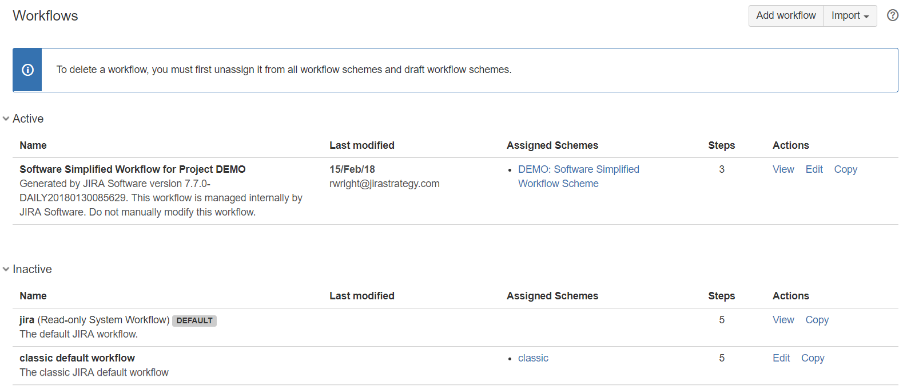
Workflow Types
Image: Admin > Issues > Workflows

Slide 5
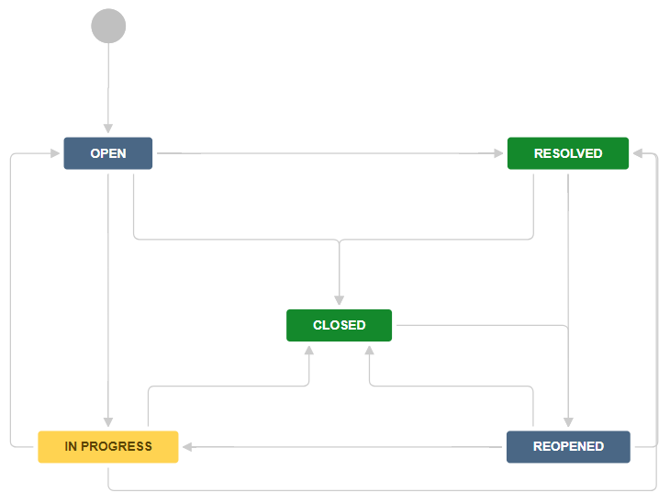
Default Workflows
Image: Read-only System Workflow (Diagram Mode)

Slide 6
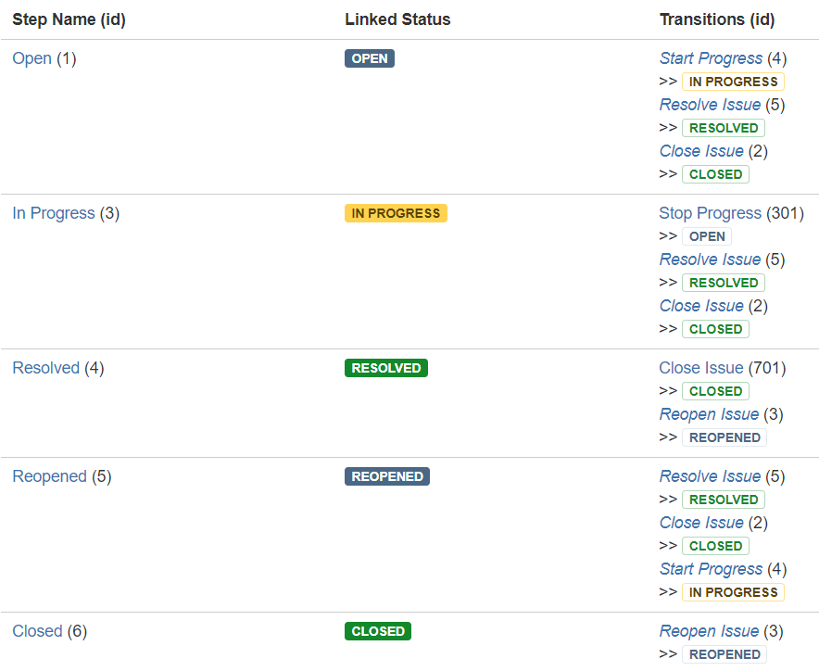
Default Workflows
Image: Read-only System Workflow (Text Mode)

Slide 7
Software vs. Business Workflows
Software
Receive Request
Review Requirements
Write Code
Test Code
Deploy Code
etc.
Business
Extra Steps
Forward & Backward Movement
Conditional
Highly Customized
etc.

Slide 8
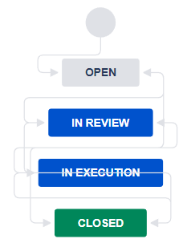
Sample Workflow
Image: Legal Contract Workflow (Jira Cloud)

Slide 9
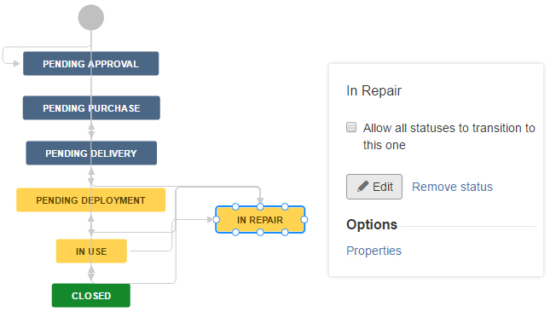
Sample Workflow
Image: Asset Management Workflow (Jira Server)

Slide 10
Resolved ≄ Closed
Image: Default Workflow

Slide 11
Do’s and Don’ts
Do
Use Proper Naming
Give Users & Admins Options
Use Appropriate Workflow Behaviors
Use Roles and Groups

Slide 12
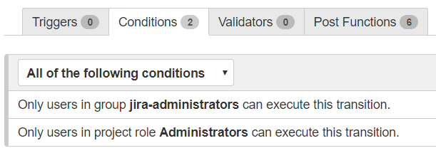
Roles and Groups
Image: Workflow Conditions

Slide 13
Do’s and Don’ts
Don’t
Add Unneeded Complexity
Create Temporary or “Dead” Statuses
Be Too Specific
Create Illogical Statuses and Transitions

Slide 14
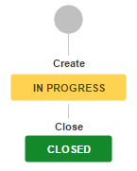
Illogical Statuses and Transitions
Image: Incorrect Expectation Example

Slide 15
Custom Workflow Planning
Phased Approach
Example: Your company is signing a partnership agreement
Open > In Review > In Execution > Closed

Slide 16
Phased Approach
In Review
Review Contract
Research
In Execution
Collect Signatures
File Records
Communication
Negotiation
etc
etc.
Open
Closed

Slide 17
Interview
Chris, Owner, Business Strategy Company
Consulting Process:
“We start off with a search for candidates and identify ideal clients we’d like to work with. We acquire a lead through various lead generation methods. We do company research prior to meeting with the candidate. We book a meeting. At the meeting, we use our “Fact Finding Template” and “Performance Checklist.” After the meeting we develop a solution, plan, or resources for how the consultant can help the company. For ongoing contracts, we’ll have weekly, quarterly, semi-annual, and annual meetings for their quarterly and long-term goals.”

Slide 18
Custom Workflow Process
Narrative
Statuses
Statuses + Forward Transitions
Statuses + Forward + Alternate Transitions
Transition Behaviors

Slide 19
Narrative
“We start off with a search for candidates and identify ideal clients we’d like to work with. We acquire a lead through various lead generation methods.”
Related statuses: Open
“We do company research prior to meeting with the candidate. We book a meeting. At the meeting, we use our “Fact Finding Template” and “Performance Checklist.””
Related statuses: Planning
“After the meeting we develop a solution, plan, or resources for how the consultant can help the company.”
Related statuses: Proposal
“For ongoing contracts, we’ll have weekly, quarterly, semi-annual, and annual meetings for their quarterly and long-term goals.”
Related statuses: Active or Closed

Slide 20
Statuses
Key: Status =
[label]
Open
Planning
Proposal
Active
Closed
In Words:
A lead is acquired and on creation is in the “Open” status. Research and meetings occur in the “Planning” status. Solutions are determined and pitched in the “Proposal” status. If the proposal is accepted, the issue moves to the “Active” status where all ongoing consulting occurs. When consulting is complete, the issues moves to the final “Closed” status.

Slide 21
Statuses + Forward Transitions
Key: Status = , Transition Button = , Happy Path =
[label]
[label]
Open
Planning
Proposal
Active
Closed
Start Planning
Start Proposal
Start Consulting
Close
In Words:
A lead is acquired and on creation is in the “Open” status. The user clicks the “Start Planning” transition button to move to the “Planning” status where all research and meetings occur. The user clicks the “Start Proposal” button to determine solutions and pitch them to the customer. If the proposal is accepted, the user clicks the “Start Consulting” button to move to the “Active” status where all ongoing consulting occurs. When consulting is complete, the user clicks the “Close” button to move to the final “Closed” status.

Slide 22
Statuses + Alternate Transitions
Key: Status = , Transition Button = , Happy Path = , Alternate Path =
[label]
[label]
Open
Planning
Proposal
Active
Closed
Start Planning
Start Proposal
Start Consulting
Close*
Reopen
Skip to Proposal
Back to Open
Back to Planning
Back to Proposal
Close*
Close*
Close*
In Words:
A lead is acquired and on creation is in the “Open” status. The user clicks the “Start Planning” transition button to move to the “Planning” status. If no planning is needed, the user clicks “Skip to Proposal” to skip to the “Proposal” status. In the “Planning” status, the user clicks “Start Proposal” to move forward to the “Proposal” status or clicks “Back to Open” to move backwards to the “Open” status. In the “Proposal” status, the user clicks “Start Consulting” if the proposal is accepted. If the proposal is declined, the user clicks the “Close” button to move to the final “Closed” status. In the “Active” status, the user clicks the “Close” button when consulting is complete. In the “Closed” status, a user clicks the “Reopen” button to reopen the issue.
* The “Close” transition is global.

Slide 23
Transition Behaviors
Status | Transition > Destination | Behaviors
All | Close > Closed | Screen: Resolution Post Function: Assign the issue to the reporter. Post Function: Fire a Issue Closed event that can be processed by the listeners.
Closed | Reopen > Open | Post Function: The value of field Resolution will be cleared.

Slide 24
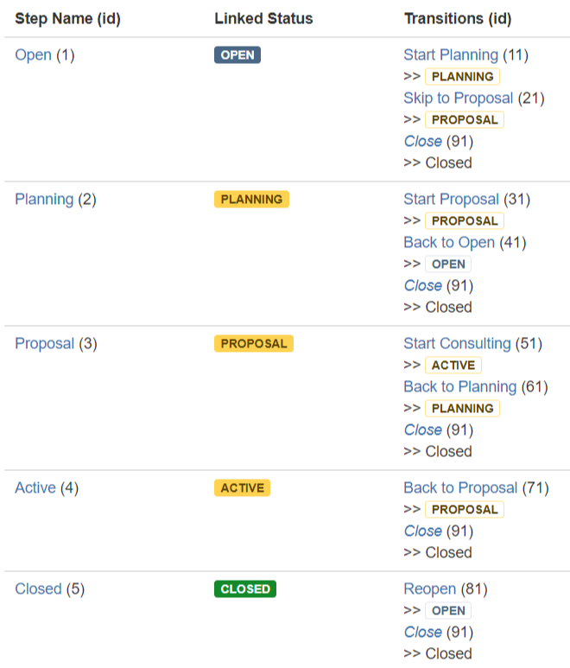
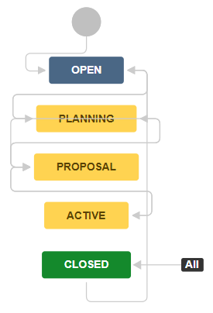
Custom Workflow
Image: Diagram vs Text Mode

Slide 25
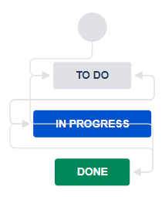
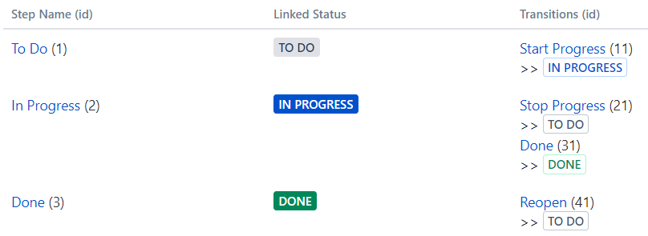
Workflow Concepts
Image: Diagram vs Text Mode

Slide 26
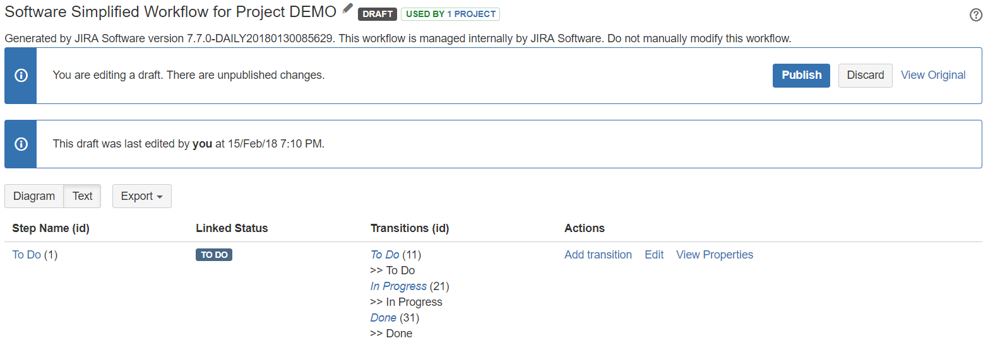
Draft vs Active
Image: Draft Mode

Slide 27
Workflow Editing Tips
Make a Workflow Copy
Build in a Test Environment
Workflow Changes Impact JQL

Slide 28
Workflow Assumptions
Image: Workflow Diagram Editor

Slide 29
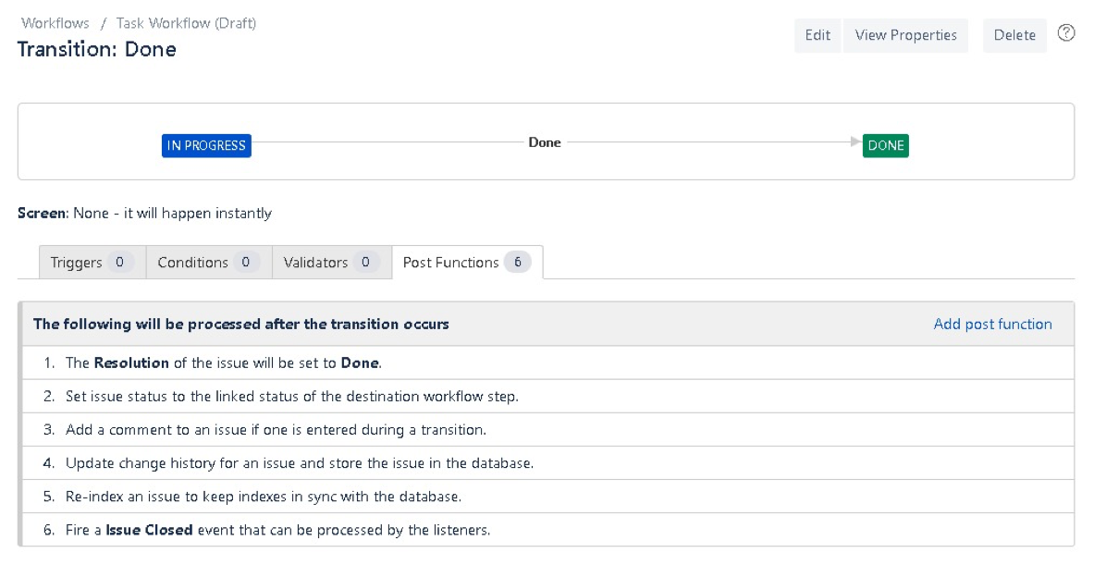
Workflow Assumptions
Image: Default Post Function

Slide 30
Transitions
Image: Standard Buttons vs Workflow Buttons

Slide 31
Transition Types
Forward
Backward
Global
Skip
Administrative
Sample Workflow:
Open > In Review > In Execution > Closed

Slide 32
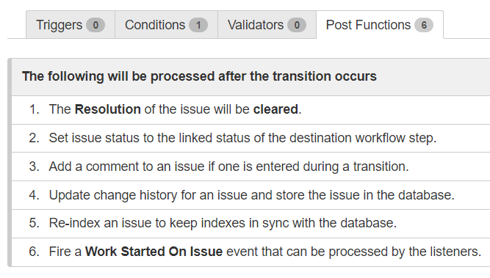
Transition Behaviors
Image: Triggers, Conditions, Validators, and Post Functions

Slide 33
Add-ons & Plugins
Explore: marketplace.atlassian.com
Install: Admin > Add-ons > Find new add-ons

Slide 34
Favorite Workflow Add-ons
Name | Link | Type
ScriptRunner for Jira | jirastrategy.com/link/scriptrunner | Paid
Create on Transition for Jira | jirastrategy.com/link/create-on-transition | Paid (Server Only)
Update on Transition for Jira | jirastrategy.com/link/update-on-transition | Paid (Server Only)
Jira Misc Workflow Extensions | jirastrategy.com/link/jira-misc-workflow-extensions | Paid
Jira Toolkit Plugin | jirastrategy.com/link/jira-toolkit-plugin | Free
Suite Utilities for Jira | jirastrategy.com/link/suite-utilities-for-jira | Paid (Server Only)

Slide 35
Resources
Test Your Knowledge
Project
Business Team Process Description
Custom Workflow Template
Sample Solution
Quiz
Visit: jirastrategy.com/business-workflows-materials

Slide 36
Resources
Downloads
Slides and Notes
Custom Workflow Template
Visit: jirastrategy.com/business-workflows-materials
Continue the Conversation
Facebook Group: facebook.com/groups/strategyforjira/
LinkedIn Group: jirastrategy.com/link/conversation
Twitter: twitter.com/rlw_www

Slide 37
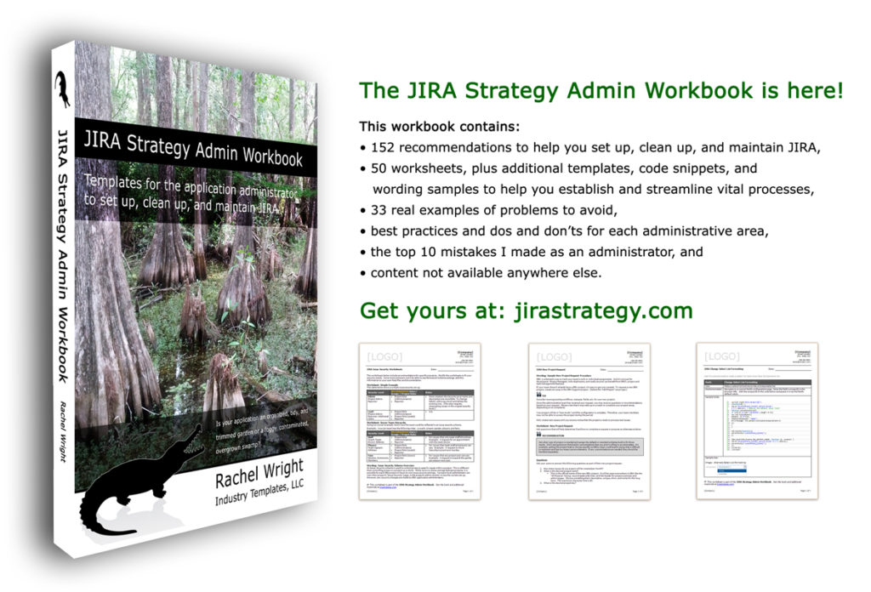
Jira Strategy Admin Workbook
Enter code skillshare at jirastrategy.com for 15% off!
Print version available at Amazon

Slide 38
Questions?
Contact: Rachel Wright
rwright@jirastrategy.com

Slide 39
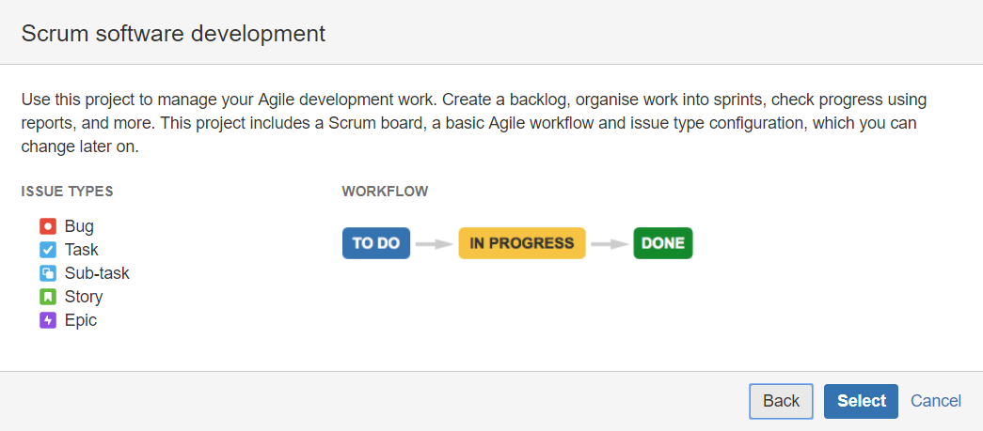
Default Workflows
Image: Software – Scrum Workflow

Slide 40
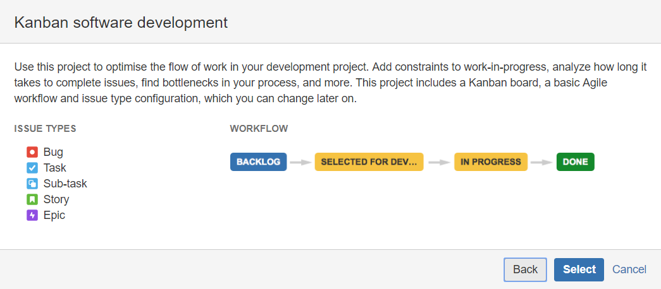
Default Workflows
Image: Software – Kanban Workflow

Slide 41
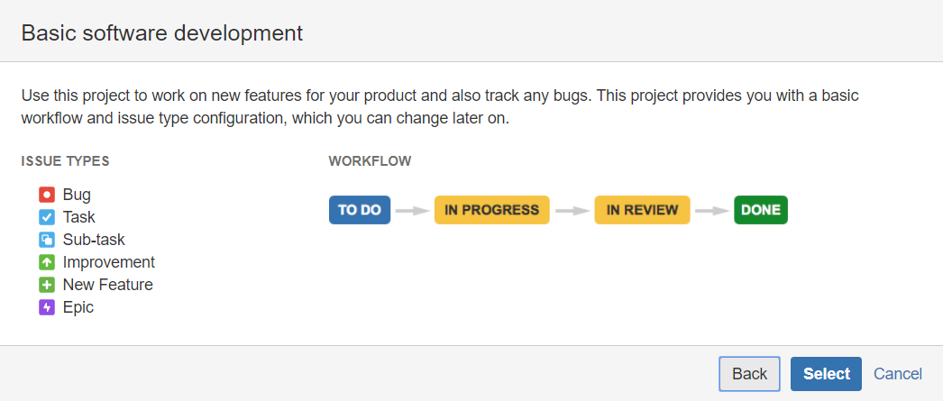
Default Workflows
Image: Software – Basic Workflow

Slide 42
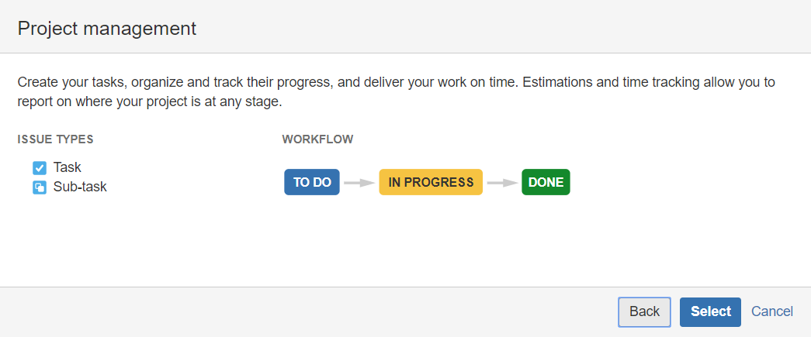
Default Workflows
Image: Business – Project Management Workflow

Slide 43
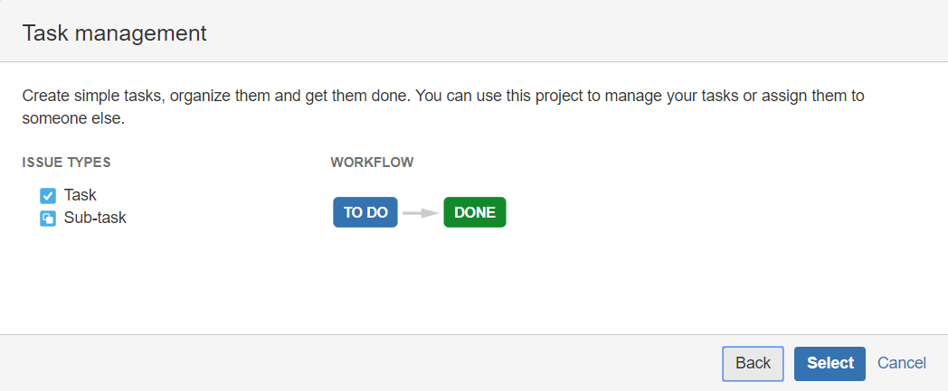
Default Workflows
Image: Business – Task Workflow

Slide 44
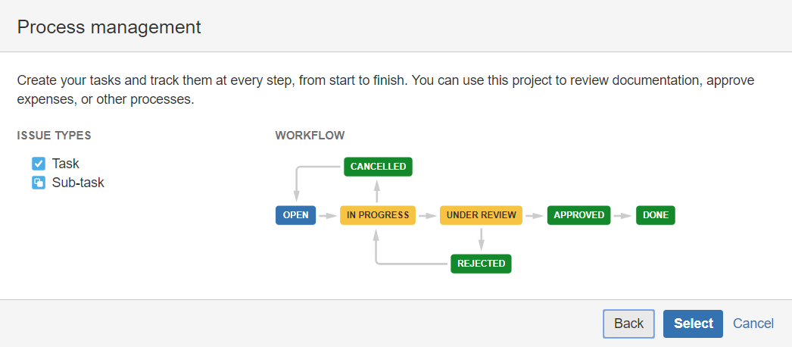
Default Workflows
Image: Business – Process Management Workflow

Slide 45
Multiple Workflows
Image: Issue Type to Workflow Matrix

